Slide 1

Team 01 Engineering Senior Design 2010-2011 Technical Review
Thursday, May 12, 2011

Slide 2
Outline
The Team
The Project
Design Norms
System Overview
Individual Subsystems
Design
Obstacles
Final Design
Financials
Project
Business Case
Questions

Slide 3

The Team
Four electrical engineering students
Mixed software and hardware experience
Amy Kendrick Nathan Avery

Slide 4
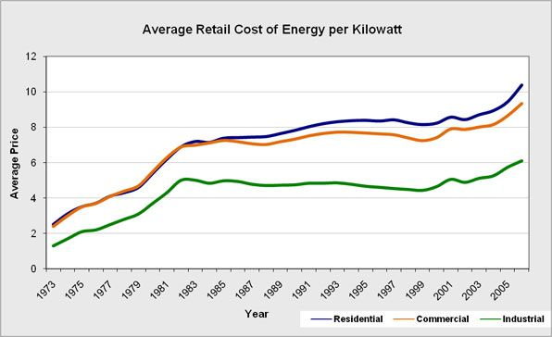
Project Selection
Notes:
Cost: http://www.project.org/info.php?recordID=247
USEIA: http://www.eecs.mit.edu/eecsenergy/

Slide 5
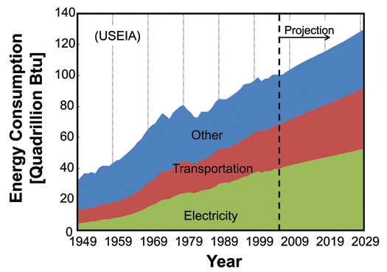
Project Selection
Price of energy is increasing.
Energy consumption is increasing.
Electric power metering
Provide useful data for more efficient consumption

Slide 6
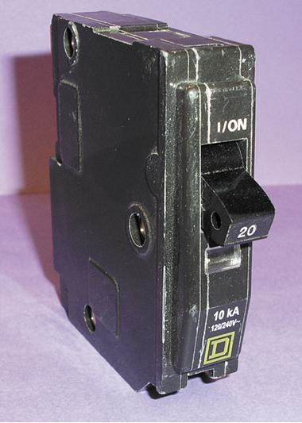
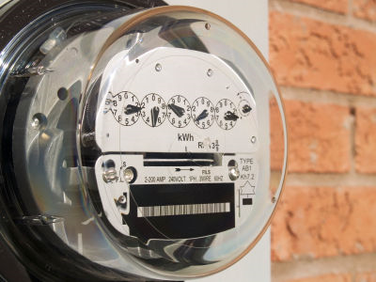
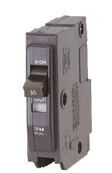
The Project
?
http://www.cpsc.gov/cpscpub/prerel/prhtml07/07036.jpg
http://sp.life123.com/bm.pix/electric-meter.s600x600.jpg

Slide 7
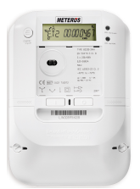
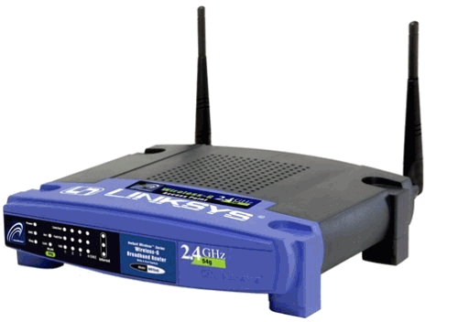
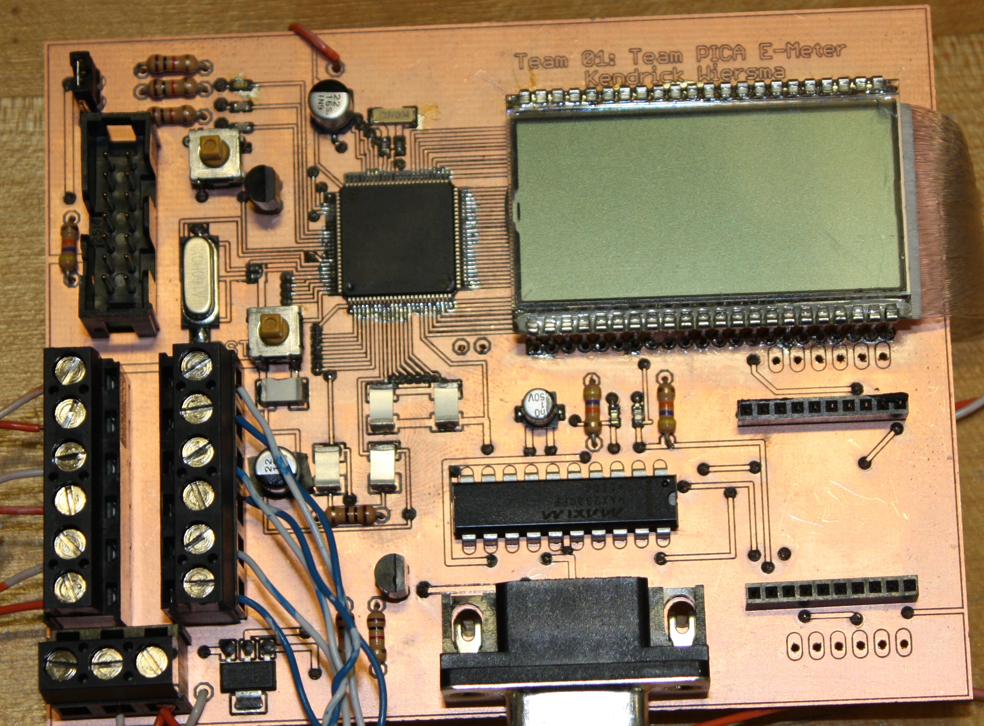
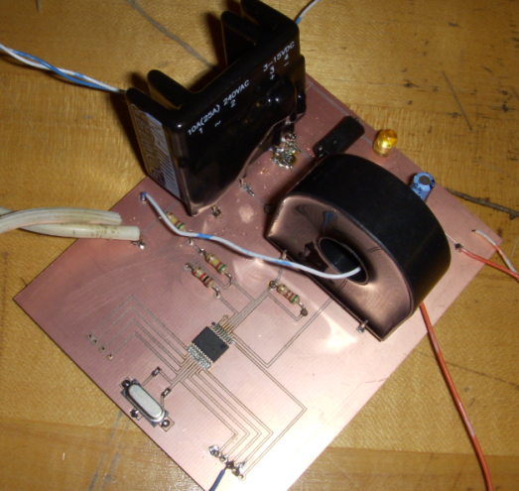

The Project
http://earlvillefreelibrary.org/images/computer_pic.jpg

Slide 8
Design Norms
Stewardship
By providing information regarding power consumption we enable consumers to make more conscious decisions about power consumption.
Transparency
The design must work as advertised and clearly alert the user to a fault.
Integrity
The design must accurately report power usage.

Slide 9
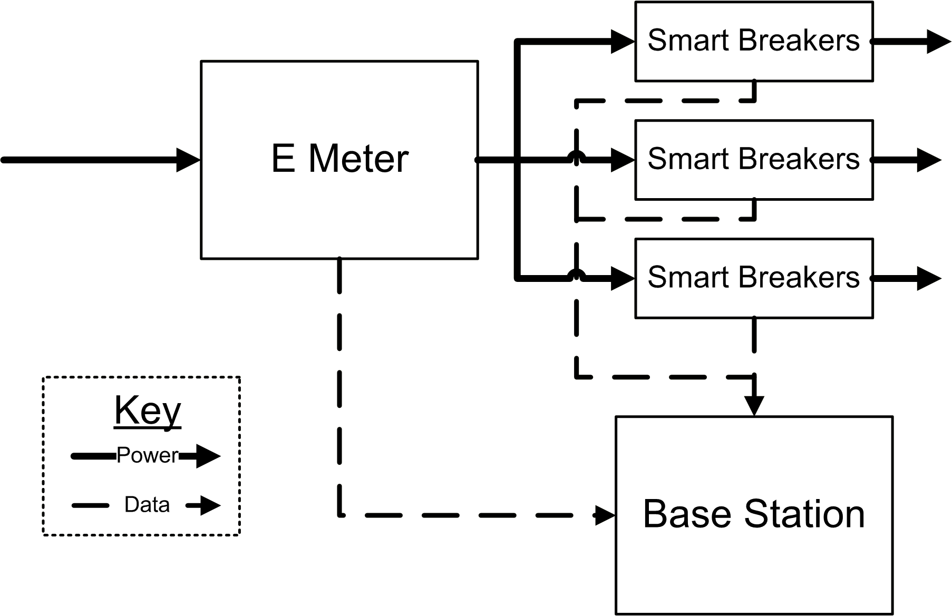
System Overview
E Meter
Measure all power
3 Phase
Smart Breakers
Measure individual circuits
Circuit interruption
Base Station
Presents information

Slide 10
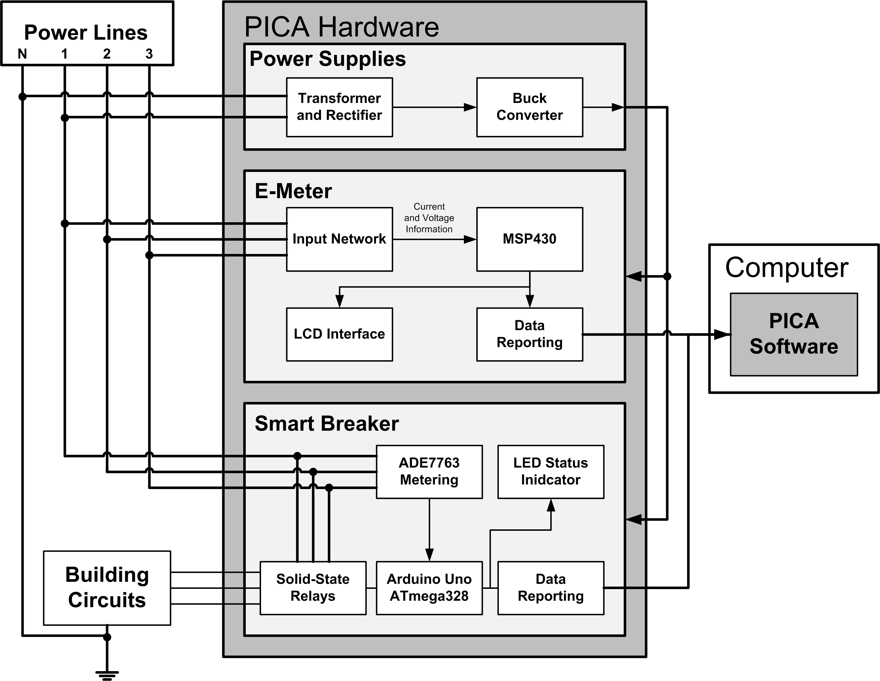
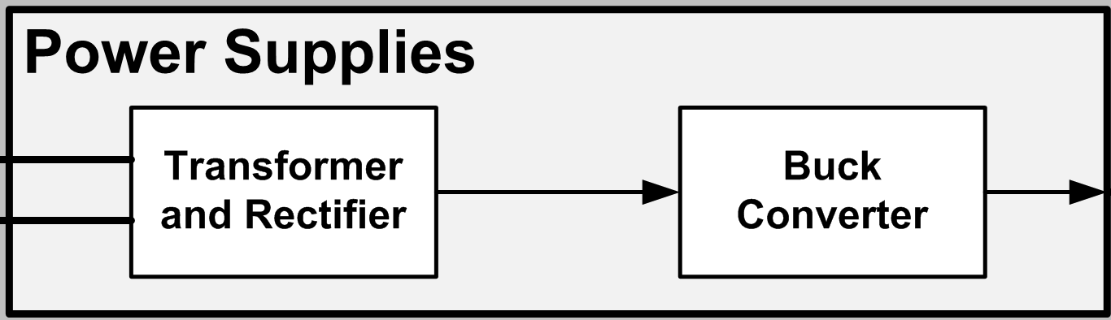
System Diagram

Slide 11
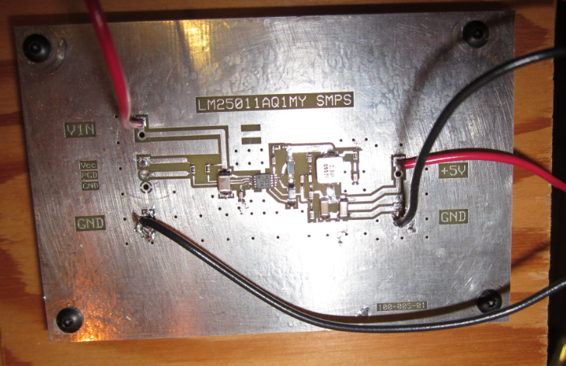
Power Supply
Technical Lead: Amy Ball

Slide 12
Power Supply: Design
Requirements
Provide 5V at 2A
At least 70% efficient
Alternatives
Switched mode vs. linear
Topologies
Decision
Bridge rectifier AC->DC conversion
Buck SMPS for DC->DC conversion

Slide 13
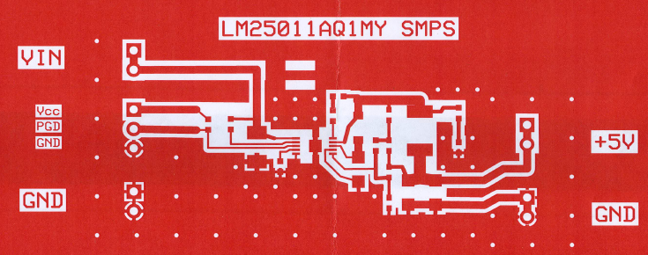
Power Supply: Buck Converter Layout

Slide 14
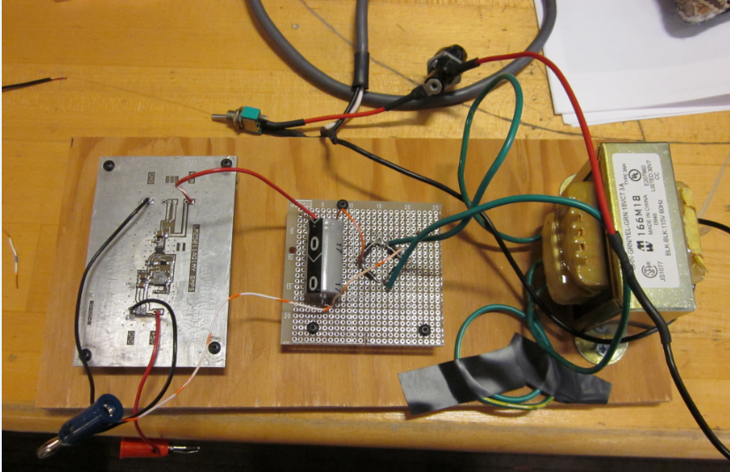
Power Supply: Final Assembly

Slide 15
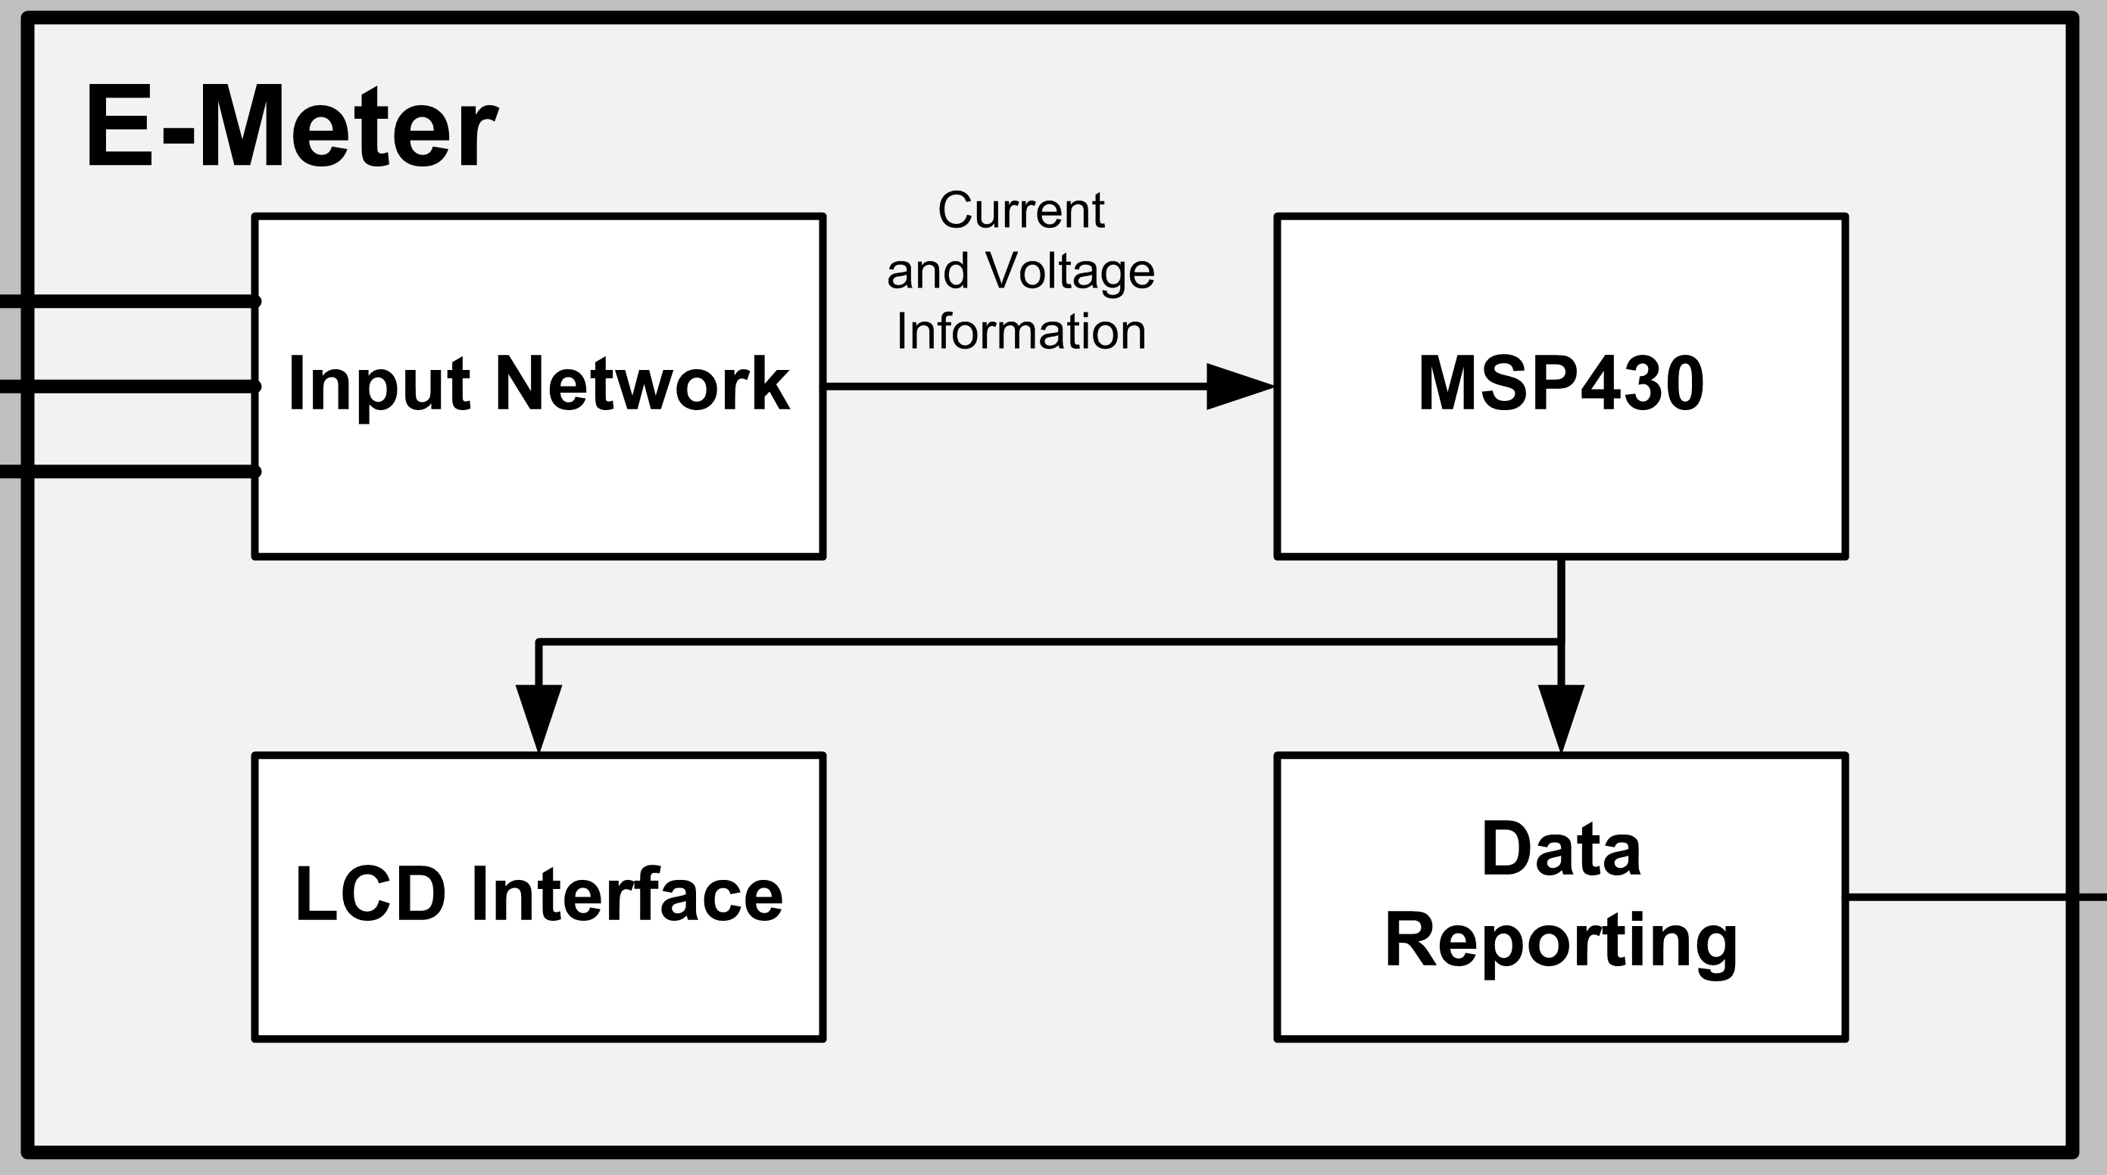
System Diagram

Slide 16
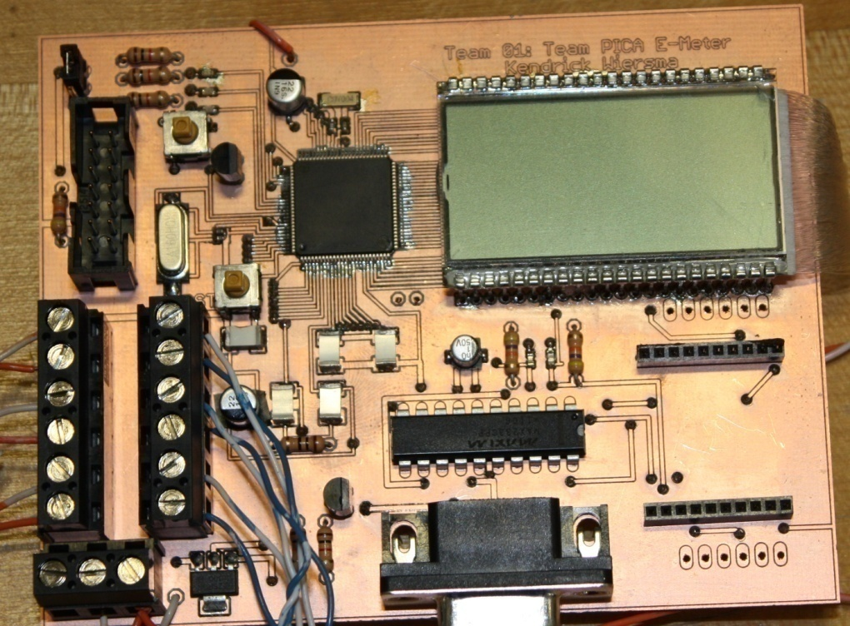
E-Meter Hardware
Technical Lead: Kendrick Wiersma

Slide 17
E-Meter Hardware: Design
MCU: MSP430 from Texas Instruments
Low power consumption
Tailored for metering applications
Integrated LCD driver
Serial Communications (RS232)
Xbee Radio
Dedicated printed circuit board

Slide 18
E-Meter Hardware: Obstacles
Obstacles
Resolution
Surface-mount components
Peripheral clocking
LCD driver
Board size limitation
JCI etched and populated board
Attach required crystals
Help from Chuck Cox of SynchroSystems in Boston.
Split board into two separate boards

Slide 19
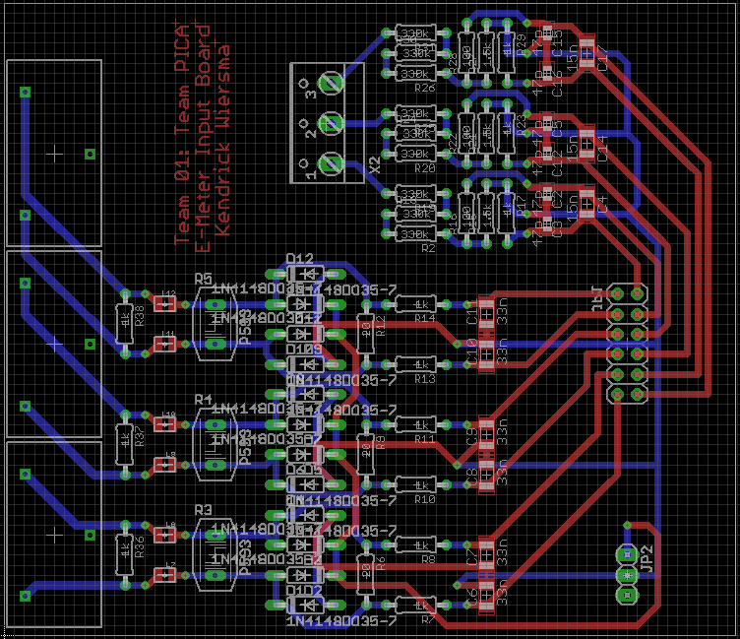
E-Meter Hardware: Input Board
Voltage Input
Current Transformers
Connection to main board

Slide 20
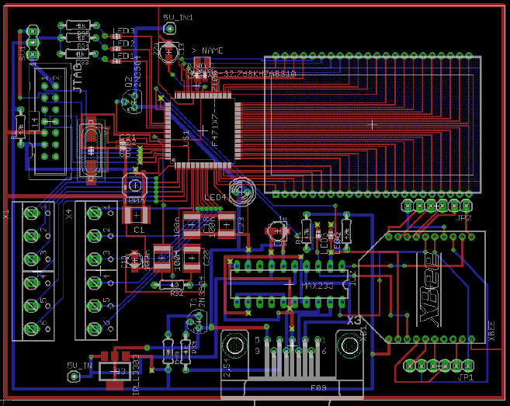
E-Meter Hardware: Main Board
MSP430 (MCU)
LCD Screen
Connection to Input board
Wireless Communication
Serial (RS232) Connection

Slide 21
E-Meter Software
Technical Lead: Avery Sterk

Slide 22
E-Meter Software: Design
Read current and voltage information
MSP430 reads analog information in hardware
Compute power and energy usage
Interpret data and crunch numbers
Run for a long time without resetting
Avoid overflowing data
Need to conserve power
Put features to sleep when not in use

Slide 23
E-Meter Software: Obstacles
Obstacles
Resolution
Interrupt-driven programming
Measurement calibration
LCD driver software was built for a different setup
Only one button for user interface
Study example code and part user manuals
Pre-compute conversion factors, verify results
Re-configure software, make HW substitutions
Create a simple interface, allow for more data sent to the base station

Slide 24
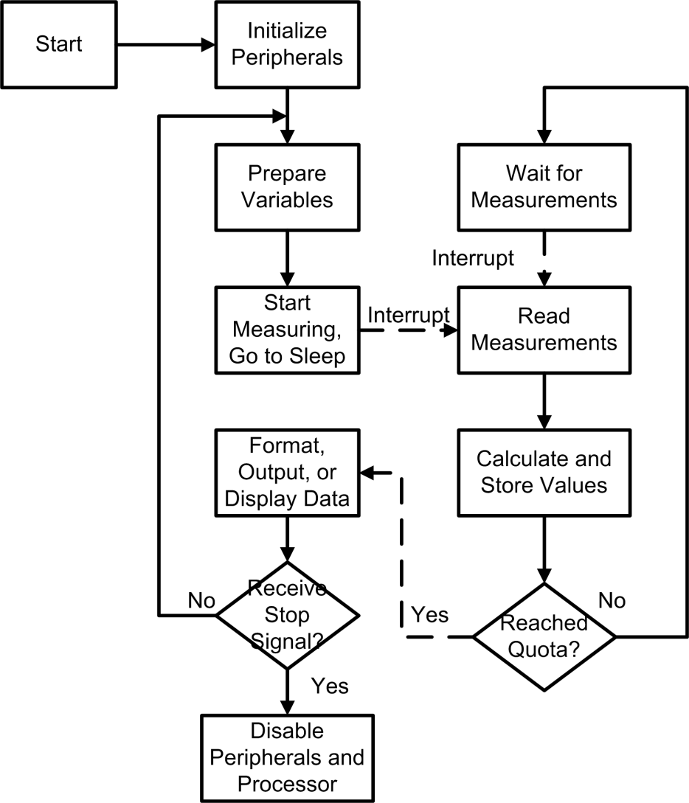
E-Meter Software: Final Design

Slide 25
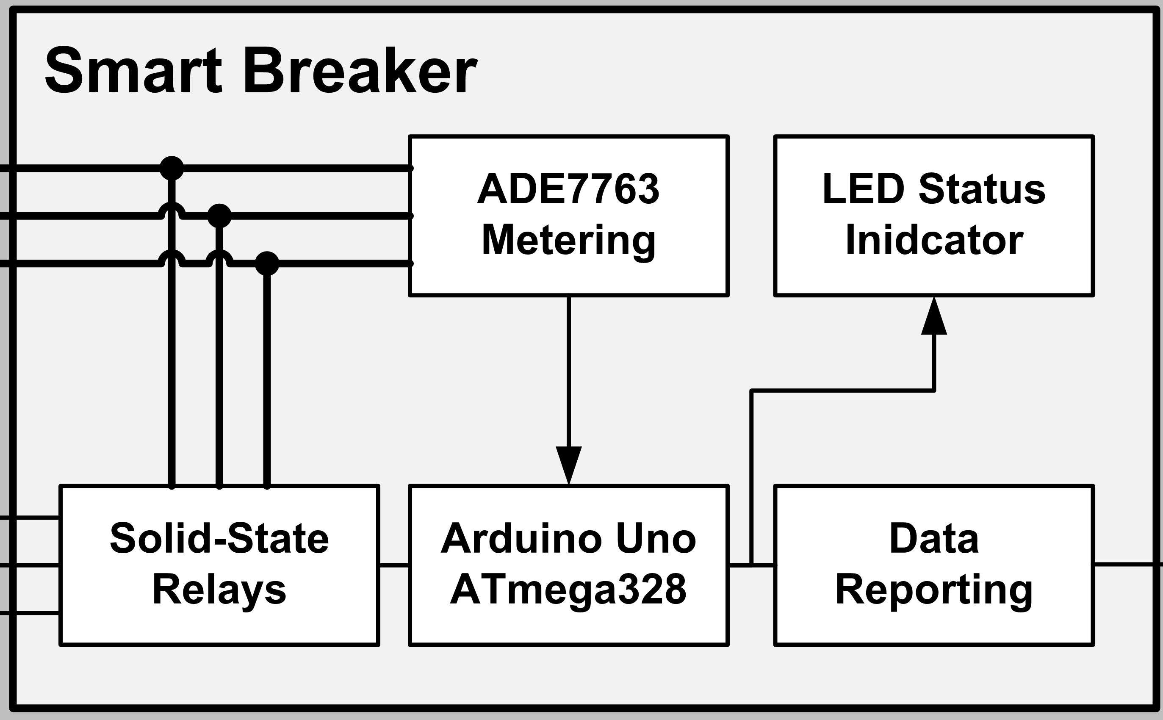
System Diagram

Slide 26
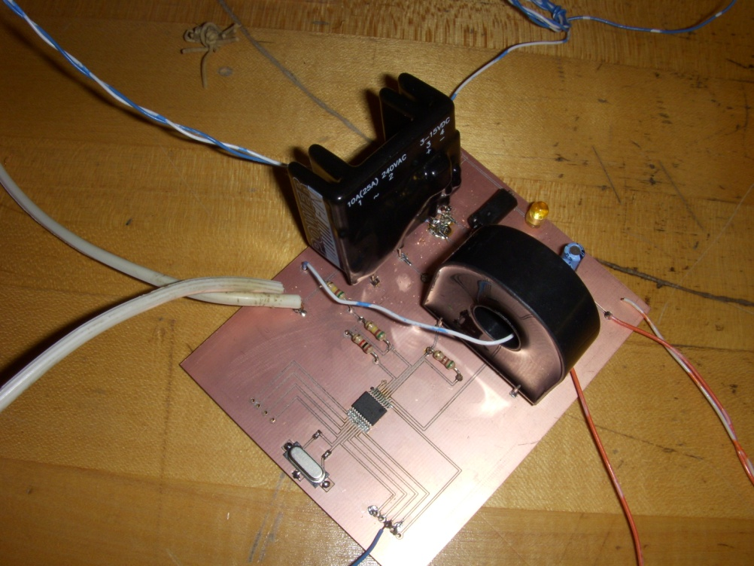
Smart Breakers
Technical Lead: Nathan Jen

Slide 27
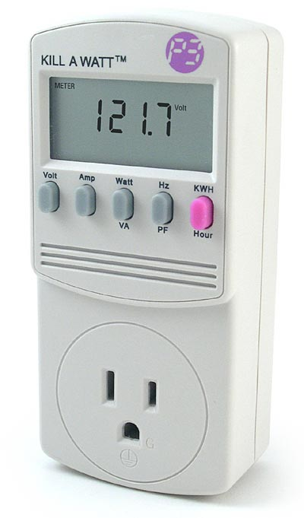
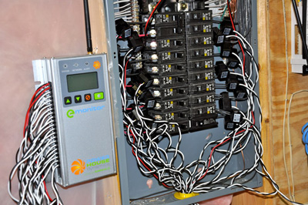
Smart Breakers
Provides the ‘map’ of where electricity is used
Conveniently located out of the way
Pictures:
http://www.home-energy-metering.com/home-energy-monitor.html
http://www.thinkgeek.com/images/products/zoom/kill_a_watt.jpg

Slide 28
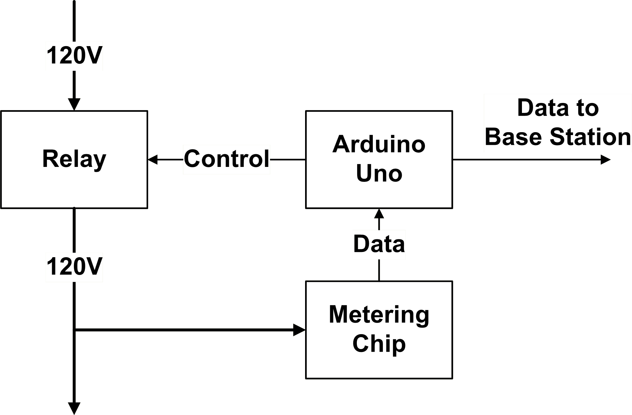
Smart Breakers: Block Diagram
Notes:
Needs cleaning, but need Visio or creative arrows & I’m too tired to be creative

Slide 29
Smart Breaker: Design Decisions
Proof of concept
Use ADE7763
NIOS II microcontroller
Solid state relay
Obstacle
Microcontroller documentation

Slide 30
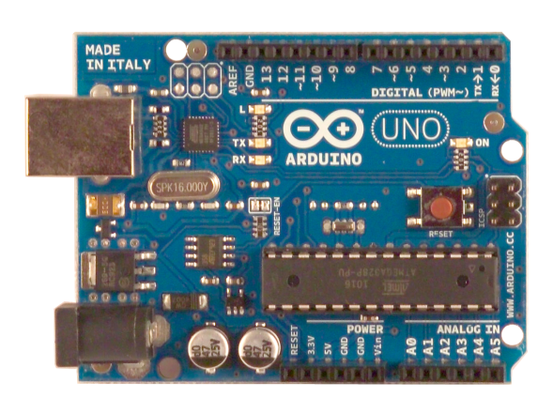
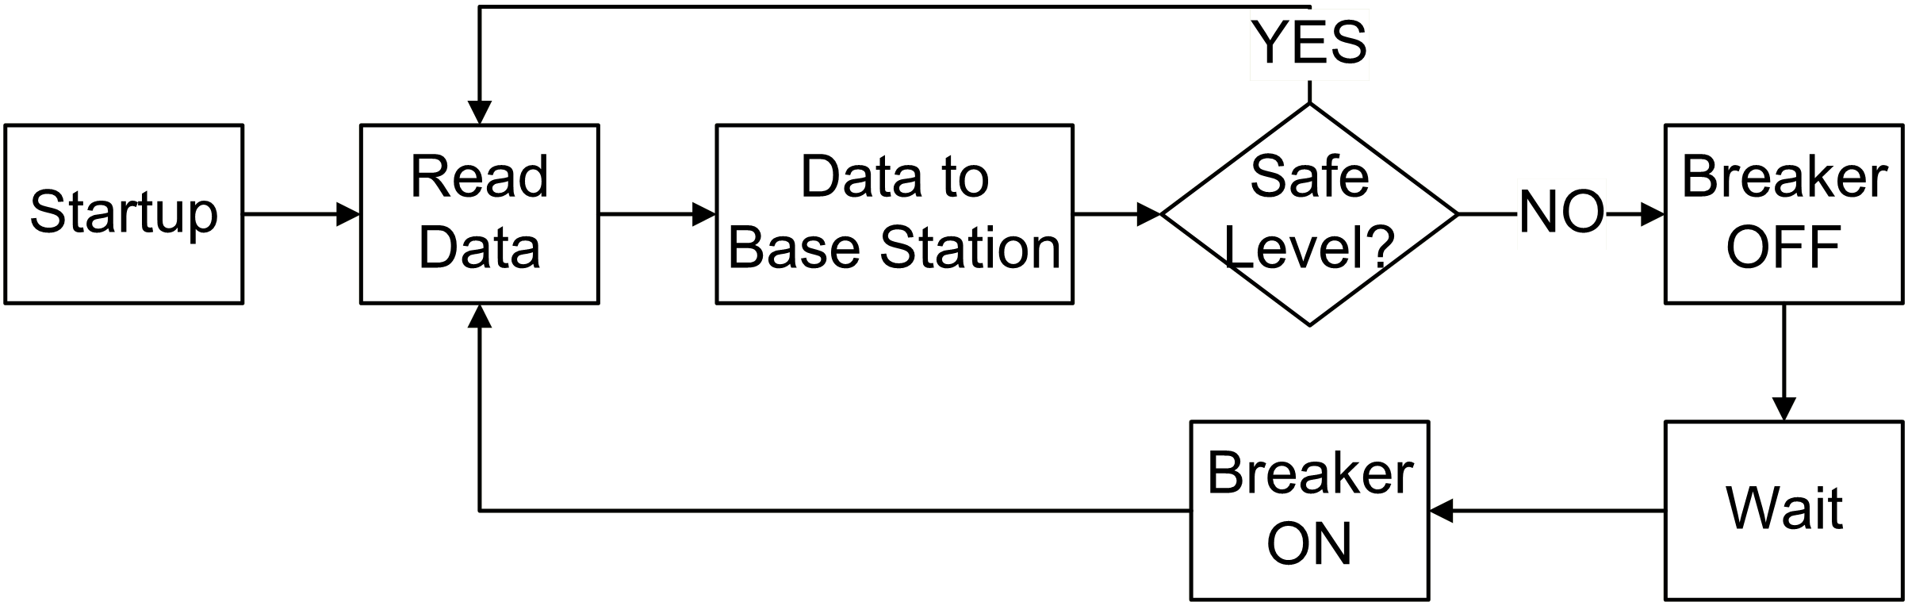
Smart Breakers: Software
Transfer data
Check for unsafe voltage & current
Arduino Uno picture: www.arduino.cc

Slide 31
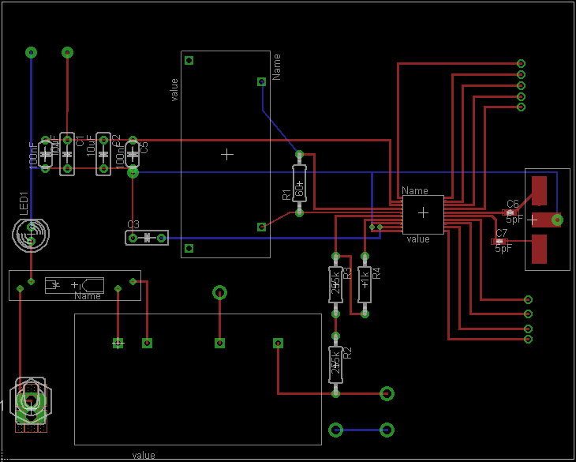
Smart Breakers: PCB
SPI Interface to Arduino
Emergency Switch
Interrupter
Metering
Device

Slide 32
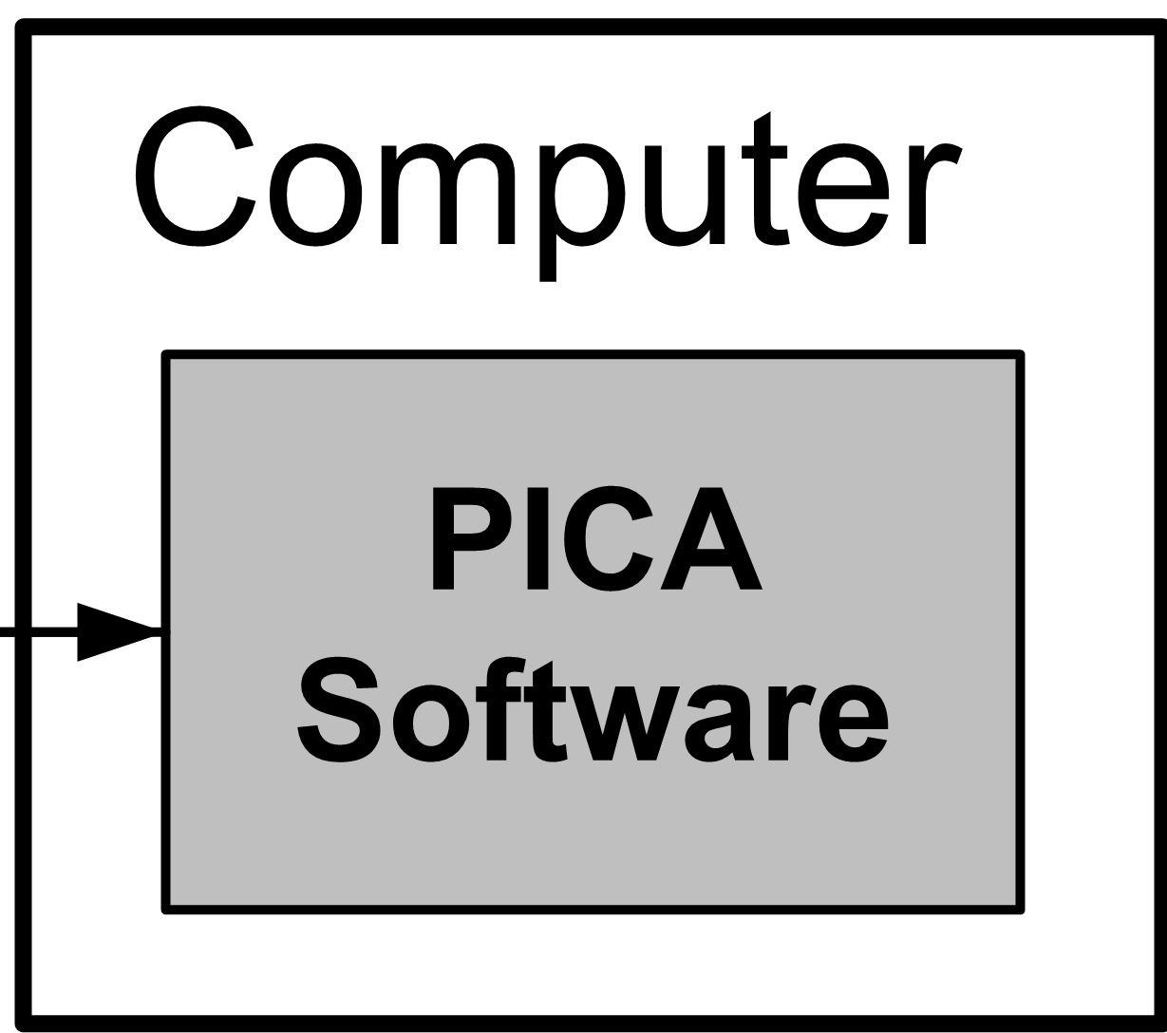
System Diagram

Slide 33
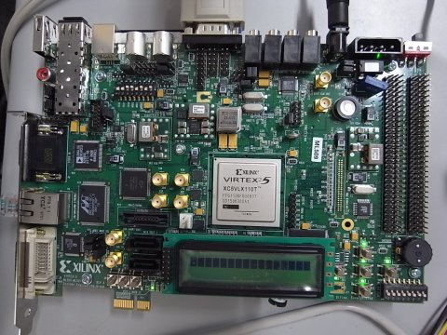
Base Station
Technical Lead: Avery Sterk

Slide 34
Base Station – Design Decisions
Needs to collect data from other subsystems
Best to have an always-on device
Needs to store data for future reference
Storage internal to the device
Needs to display information
Provide a familiar webpage-like interface
Best option: a single-purpose computer
Calvin already owned a suitable board

Slide 35
Base Station – Obstacles
Obstacles
Resolution
Processor selection
Operating System
Linux distribution severely disorganized and broken
Bootloader doesn’t work well with our Linux
LEON3 softprocessor (SPARC compatible)
Bundled Linux distribution
Built a custom Linux distribution from scratch
Change in scope: focus on collection software

Slide 36

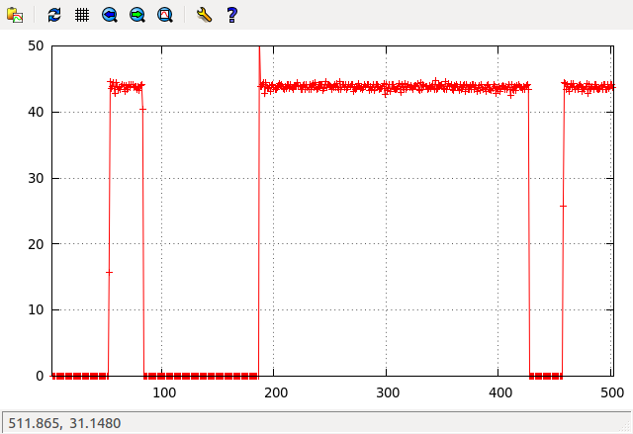
Base Station – Final Design
Perl script to manage a ZigBee network
Use Perl and Gnuplot to chart data
Camel Logo by O’Reilly Media, from www.perl.com

Slide 37
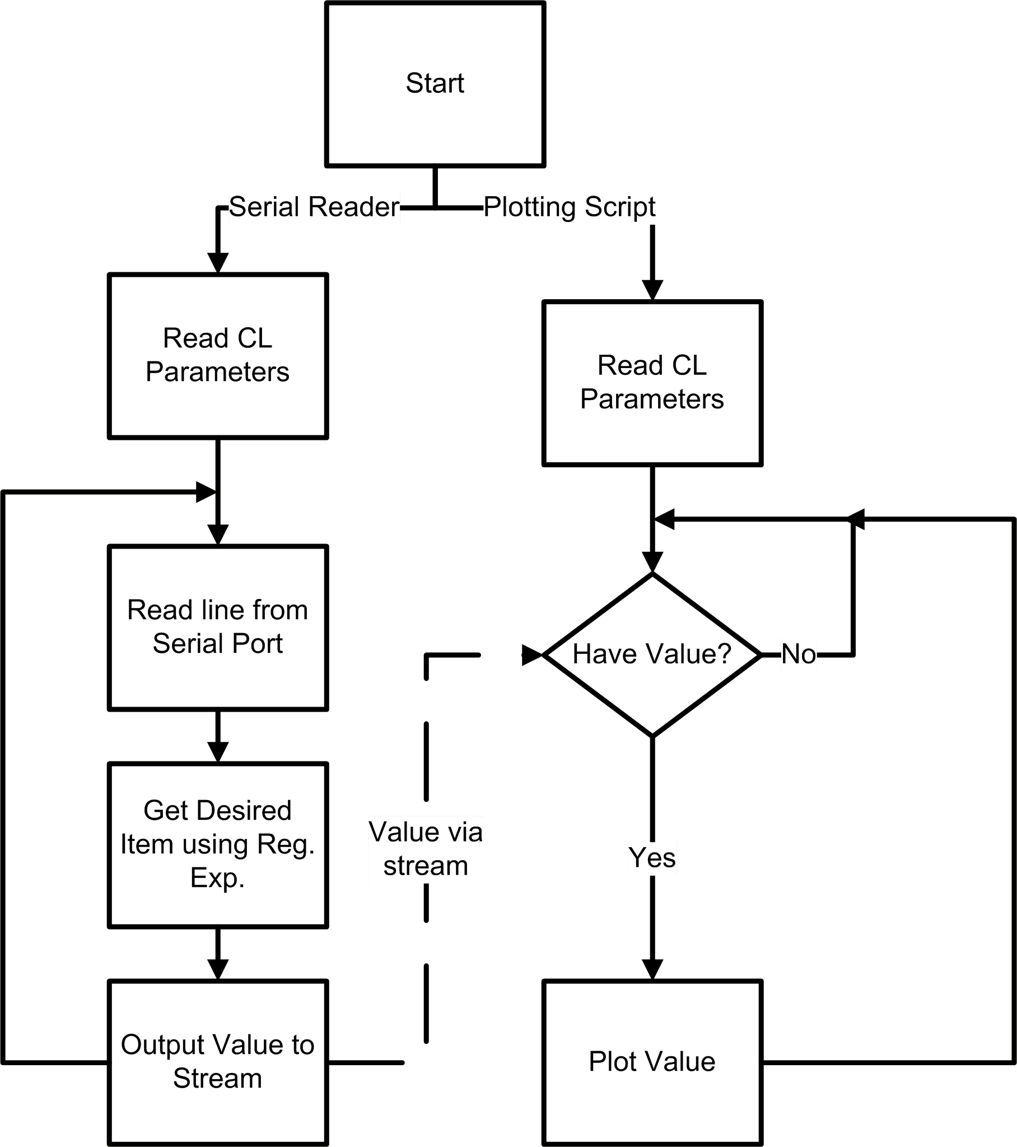
Base Station: Software Flowchart

Slide 38
Project Finances
$222
$403
$350

Slide 39
Project Finances
Budgeted
$974 for prototype
Includes cost of spinning two PCBs.
Did not include development boards.
Actual
Granted $700 for prototype.
Used $264 for materials
Used $100 for spare parts and demo.
Received $640 in donated materials and services.

Slide 40
Production Finances
Business Estimates
192,000 Smart Breakers
64,000 Base Station
830,000 E-meter
Each of these on a per-year basis.

Slide 41
Business Finances
Fixed Costs
Marketing | $120,000
Legal | $17,000
Facilities | $11,500
Total | $148,500
Variable Costs
Parts/item | $277
Labor/system | $44
Shipping/system | $16
Total/system | $337

Slide 42
Scheduling
Manage Course Deadlines
Initially take dates from the syllabus
Revise dates using Moodle and e-mail.
Identify dependencies
Construct critical linkages
Remain flexible to emergencies
Set review dates to give “buffer” time and ensure quality of work.

Slide 43
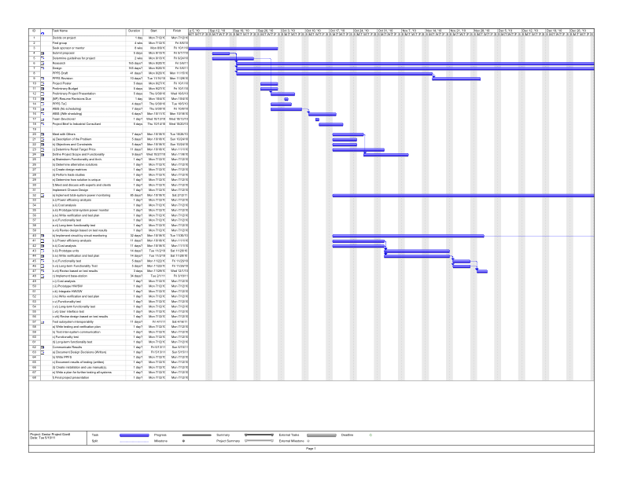
Scheduling
Originally used a Gantt Chart

Slide 44
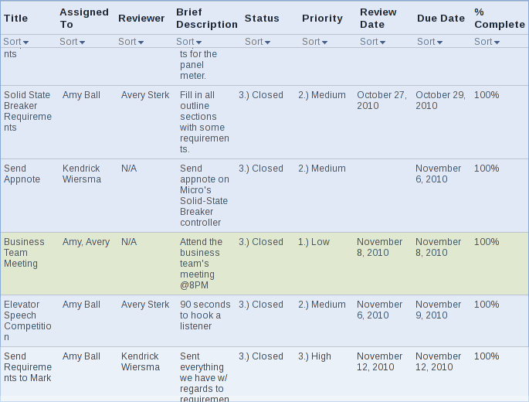
Scheduling
Switched to Google Sites to track tasks and hours worked.

Slide 45
Time Management
Team Hours:
1st Semester: 403
2nd Semester: 650
Total: 1050
Schedule Performance:
Consistently behind schedule on project tasks
Ahead of schedule on class tasks

Slide 46
Questions
? ? ? ?

Slide 48
Backup Slides

Slide 49
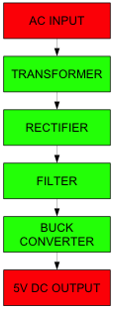
Power Supply Block Diagram

Slide 50
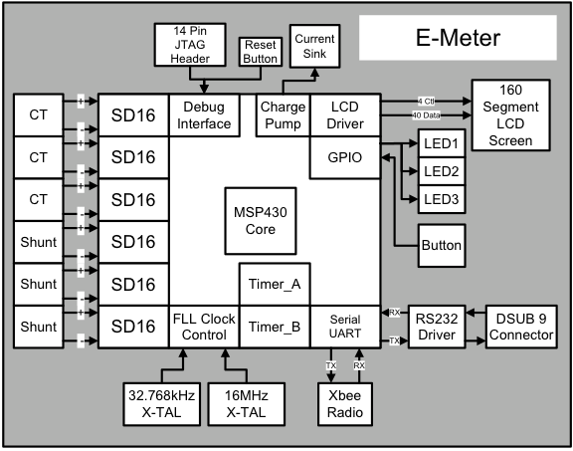
E-Meter Block Diagram

Slide 51
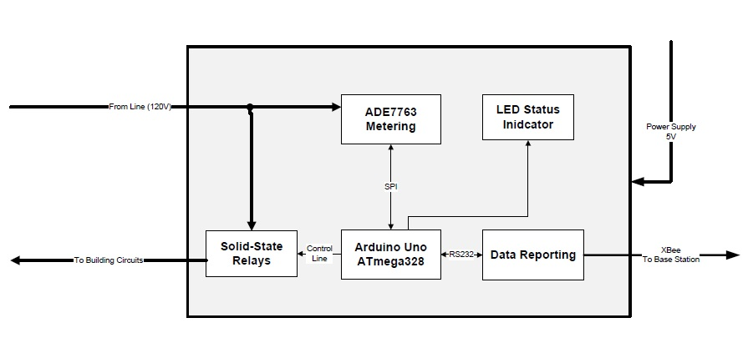
Breakers Block Diagram

Slide 52
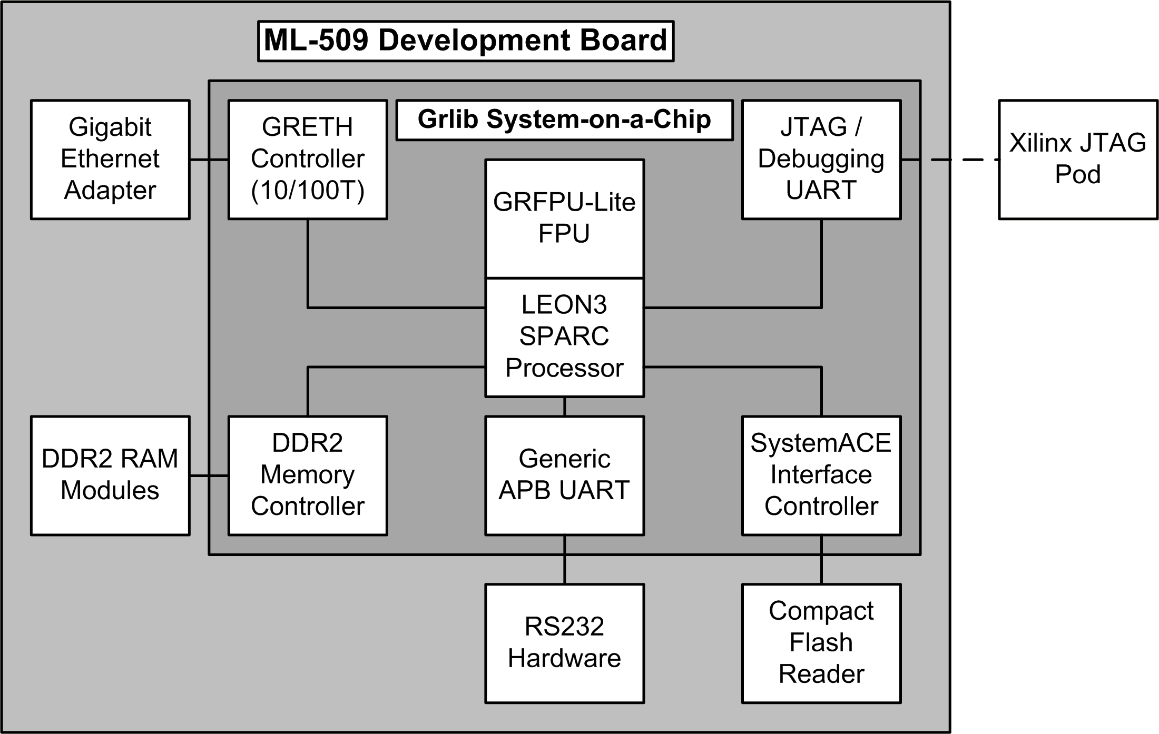
Base Station Block Diagram

Slide 53
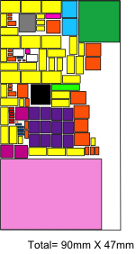
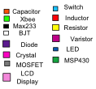
E-Meter Board Estimate

Slide 54
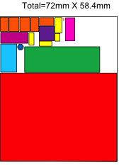
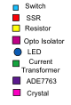
Smart Breaker Board Estimate

Slide 55
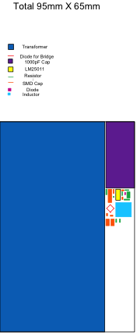
Power Supply Board Estimate

